Slide 1
Part 2
Quarterback analysis using advanced data

Slide 2
More data, proof and observations
Before I get into advanced Quarterback statistics, I want to look through Quarterback situation. It’s in my opinion that Tom Brady has just profited off of extremely successful defenses, defenses I believe won him at least half his Super Bowls. Especially in comparison to some of the other top QBs of all time, like Rodgers, Manning and Brees, even Mahomes as well. Team performance is not super crucial to why I believe Tom Brady is not the “GOAT” however, it is something that he’s extremely profited on, and I believe it is something that can and will showcase that his defenses have consistently been some of the best over his career, especially in comparison to other QBs and their teams. I chose to use team Defense EPA/play, over the course of each QBs career to measure and highlight how lucky Tom Brady got to be put on a team with such great defensive efficiency. I only considered the seasons when they were the starting QB for at least 10 games.

Slide 3
Tom Brady’s defenses EPA/play
Tom Brady Patriots: 2001-2007
To start his first 7 seasons in the NFL, Tom Brady had the 5th best defense in the NFL with an EPA/play value of -0.064. The best value for any of the QBs from their stint of their first team in the NFL.
2009-2019
After missing the 2008 NFL season, the Patriots over the next 11 seasons had the 8th best defense in the NFL, with an EPA/play of -0.029. Again, his defense essentially prevented and gained points per play.
Buccaneers: 2020
In his inaugural season with the Tampa Bay Buccaneers, he was a part of (again) the 5th best defense in the NFL in terms of EPA/play with an EPA/play of -0.037.

Slide 4
Aaron Rodgers’s defenses EPA/play
Aaron Rodgers Packers: 2008-2012
Throughout his first five seasons starting with the Packers, he had very successful defenses, with the 6th best defense in the NFL over that course of time with an EPA/play value of -0.049.
2014-2016
In these next 3 seasons the defense regressed to 12th in the NFL with an EPA/play of -0.009, not the best or as good as it was, however it was still solid.
2018-2020
The defense regressed even more, declining to the 17th ranked defense in the NFL in terms of EPA/play, in addition to giving up 0.018 points per play based on their EPA/play.

Slide 5
Peyton Manning’s defenses EPA/play
Peyton Manning Colts: 1999-2010
In his career as the Colts starting Quarterback, the Colts were 21st in the league in defense EPA/play, with an EPA/play of -.007 meaning that the defense essentially gained .007 points per play.
Broncos: 2012-2015
In the second part of his career, Peyton Manning was given the blessing of playing with a good defense. Throughout his time with the Broncos, they ranked 3rd in defense EPA/play with an EPA/play value of -0.070. A very good mark.

Slide 6
Drew Brees’s defenses EPA/play
Drew Brees Chargers: 2002-2005
Something notorious from media in Drew Brees’s career is the fact that he’s been on many fantastic offensive teams with horrible defenses to show for it. Within his career with the Chargers the same saying is true, the Charger defense was 26th in EPA/play with an EPA/play of 0.022.
Saints: 2006-2020
In current time, the Saints defenses have actually been fairly solid. However, throughout of a majority of his time with the Saints, Brees had to deal with horrible defenses. Throughout his career with the Saints, the Saints defense had the 25th best EPA/play in the NFL, with a value of 0.016.

Slide 7
Patrick Mahomes’s defenses EPA/play
Patrick Mahomes Chiefs: 2018-2020
Obviously, as I’ve stated earlier, there is such a small sample size for Patrick Mahomes’s career numbers, however, the Kansas City Chiefs, from 2018-2020 has been in the bottom tier of the NFL. The team EPA/play is 0.046, meaning that the Chiefs defense gives up an expected .046 points per play.

Slide 8
Surprise Surprise
In a shocking turn of events, Tom Brady’s defenses have been extremely successful in terms of EPA/play, especially in comparison to these other QBs. Out of all of these QBs Tom Brady was the ONLY ONE who (let me stress THE ONLY ONE) whose team had a top 10 defensive EPA/play over their careers. It’s so surprising that this happened because NOBODY gives credit to the Patriots defenses over the course of the Patriots dynasty. Everyone attributes that success to Brady despite the exhausting fact that he was the only QB out of all these great QBs to have a top 10 defense in EPA/play over every single span in which they were the starting QB in the course of their careers. Drew Brees’s notoriously bad defenses have low EPA/play values, always positive. Patrick Mahomes, despite the extremely small sample size, his defenses are terrible as well giving up almost 0.05 expected points added per play. Peyton Manning’s defenses have been fairly solid, however he spent a majority of his career with a below league average defense when he was with the Colts, who fortunately had a negative EPA/play, which was barely below zero. Aaron Rodgers’s defenses have been solid throughout his career. For his first 2 starting stints his defenses have been above average-to-good, having negative EPA/play values. However, in the last 3 years of his career, his defense has been average, and has given up positive numbers to the opponent. None of these QBs however, have defenses that compare to Tom Brady’s.

Slide 9
Tom Brady’s defense in the playoffs
Let’s take a look at the Patriots defensive EPA/play performances in their Super Bowl wins in 2001, 2003, 2004, 2014, 2016 and 2018. In 2001 they had an EPA/play of -0.082, in 2003 they had an EPA/play of 0.014, in 2004, the Patriots defense had an absurdly successful defensive EPA/play of -0.102. In the latter part of his career, starting with the 2014 playoffs, the Patriots had a defensive EPA/play of 0.049, in 2016 they had a defensive EPA/play of -0.111 and lastly, in the 2018 playoffs they had a poor EPA/play of 0.041. Overall in 3 out of 6 of their Super Bowl win playoff appearances the Patriots defense had extremely good play shown in their very high EPA/play data. On average in their Super Bowl runs, the Patriots defense had roughly an EPA/play of -0.032. It’s absolutely crazy that Tom Brady has 6 Super Bowls with a defense that actually gains roughly 0.032 points added per play. In this past Super Bowl in 2020, with the Buccaneers, had an EPA/play of -0.065, almost as if the defense helped the team gain expected points on a per play basis in the 2020 playoffs. In 4 out of 7 of his Super Bowls, Tom Brady has had a defense with at least an EPA/play of -0.065 in 4 out of his 7 Super Bowl runs. It’s not some small value of defensive gains over a large period of time. Brady’s defenses in his Super Bowl run, especially in 4 out of the 7 wins have largely been successful in the playoffs.

Slide 10
Aaron Rodgers’s defense in the playoffs
Rodgers, unlike Brady, hasn’t been able to profit off of his defenses success in the postseason. From 2008-2020, in the postseason, the Packers defense has the 27th worst defense in terms of EPA/play with a value of 0.092. If you calculate the defensive EPA/play minus the Super Bowl run, the defensive EPA/play is roughly 0.115, meaning that in the playoffs Aaron Rodgers’s team gives up about 0.115 points added per play. It’s crazy because when you compare these numbers to Tom Brady’s teams in his Super Bowl runs (-0.037 on average) Tom Brady’s team gives up 0.152 less points. Crazy how his team has more Super Bowls when that happens. Tom Brady’s defenses have objectively been much better than Aaron Rodgers’s so obviously the team will have more championships.

Slide 11
Peyton Manning’s defense in the playoffs
Throughout the playoffs in Peyton Manning’s career with the Colts from 1999-2010, the Colts defense had an EPA/play of 0.020, which is not ideal, but solid. However, if you take out the data for the Colts playoff EPA/play minus their EPA/play from their Super Bowl run, their new EPA/play would be raised to .0509, which is objectively worse than any of the Super Bowl wins for Tom Brady. Obviously Tom Brady will have better career accolades if during his playoff Super Bowl runs his defense has an EPA/play of -0.037. In his time with the Broncos for four years (from 2012-2015) however, the Broncos defense had an EPA/play of 0.009 yet they still won a Super Bowl. In 2012 they had an EPA/play of 0.149, in 2013 they had an EPA/play of 0.141, in 2014 they had an EPA/play of 0.102 and in 2015 (their Super Bowl year) the Broncos defense had a great EPA/play of -0.179. It’s crazy because it’s almost as if when the defensive performance is good, the team wins. Take out Manning’s defenses in their Super Bowl runs and the defensive EPA/play is 0.050. If you compare EPA/plays, Tom Brady’s defenses in his Super Bowl runs prevent about 0.087 points added per play. Tom Brady’s defenses have been objectively more efficient than Manning’s, which has definitely played a huge part in why his teams have been much more successful.

Slide 12
Drew Brees and Patrick Mahomes
Drew Brees made the playoffs with the San Diego Chargers once, in that playoff appearance the Chargers had a defense EPA/play of 0.143. With the Saints, in 9 playoff appearances from 2006-2020, Drew Brees’s defenses have had a 0.051 EPA/play. Surprisingly, a lot worse than Brady’s defenses. In addition to Brees, Patrick Mahomes’s defenses have also been poor. In 3 playoff appearances, his defenses have an EPA/play of 0.065. Even in the years both of these players won the Super Bowl, their defenses still gave up more than 0 points added per play. Brees (0.020) and Mahomes (0.073) Meaning that despite extremely poor defensive play they were still able to perform well enough in spite of their defenses.

Slide 13
Overall
Defensive EPA/play is not the finite stat that measures defensive play and efficiency. It’s a measurement that measures defensive effectiveness on a per play per drive per game basis. I believe it to be an extremely useful stat to measure a defense. There are other useful statistics to use such as DVOA, or use traditional metrics like points or yards allowed. Based on EPA/play, Tom Brady has a much higher advantage. While Aaron Rodgers and Peyton Manning have their Super Bowls only coming from when their defenses were extremely successful, Tom Brady has the benefit of his defenses being extremely good, as in 4 out of his 7 Super Bowl wins, his defenses have at least an EPA/play value of -0.065 and in all of his Super Bowls, on average an EPA/play of -0.037. These numbers don’t apply to both Rodgers and Manning, which is a huge reason as to why they don’t have the team Super Bowl numbers Brady does. Mahomes (with a small sample size) and Brees both won their Super Bowls in spite of defensive incompetence, something that Brady doesn’t really have to deal with, Tom Brady has a CLEAR advantage of team defense based on defense EPA/play.

Slide 14
Advanced Quarterback Data
In addition to statistics like Passer Rating, Touchdown %, Interception % and Yards/game, I decided to look at more advanced data that evaluate quarterback performance. Such as:
DYAR
DVOA
EPA/Play
CPOE (not measured before 2006)

Slide 15
DVOA: Defensive Value over Average
DYAR: Defensive-adjusted Yards Above Replacement
To explain DVOA simply is that it evaluates the opponent and the game situation. DVOA is a metric that “measures a team or players efficiency on every single play to a league average based on the situation and the opponent.” For example, a 3-yard rush on a 3rd and 22nd will not be valued highly, if valued at all. However, a 3-yard rush on a 4th and 2 would be valued a lot more. Additionally, if that rush on 4th and 2 happened to be in the red zone it would be valued even more. Plays are deemed success and judged on a “success rate” based on the play and game scenario, such as .64 for a 10 yard run on 3rd and 1 (just a random example). DYAR is an estimation (based on DVOA) of how many fewer yards a generic replacement player (ie. backup) would be worth X amount of yards. For example, in the 2021-2022 season Jonathan Taylor has the highest RB DYAR of 510, meaning that if he were to unfortunately get hurt a replacement player would be worth 510 less yards than Taylor.

Slide 16
EPA/play: Expected points added per play
CPOE: Completion percentage over expected (Comp% - Expected Comp%)
EPA/play is a statistic, similar to DVOA, that measures the value of individual plays based on game situation. It’s done by calculating the expected points based on the down, distance and field position at the beginning of a play in contrast to its result. Basically a point estimation for the points added for a 1st and 10, and if for instance, the quarterback gets sacked for a 10 yard loss, the points added from that play would be negative, lowering the overall EPA. However, if there was a pass for 20 yards and a first down that low expected points added value would increase. This can be seen in an example from Super Bowl XLIII, “After an interception, the Arizona Cardinals take over on the 34 of the Pittsburgh Steelers. They start the drive with a 3.31 EPA, which makes sense, as they are already in field goal range. Two incompletions lower that to 2.08, before a 3rd-and-10 conversion to Tim Hightower raises the EP to 3.97, an EPA of 1.89.” The 3rd down conversion play is valued at 1.89 because that is how many expected points that one play added to the previous estimation. CPOE is an advance metric to measure QB performance. There is a calculation of the probability a pass will be completed using different variables such as field position, down and distance, era and air distance to name a few. That expected value is calculated and then subtracted from the actual completion % value, leaving you with the completion percentage over that expected value calculated. CPOE is an effective measurement of how accurate a QB is, however it doesn’t take into account other variables like the performance of the wide receiver, such as separation from the defender or the skill level.

Slide 17
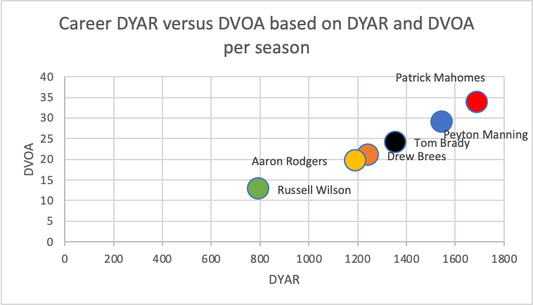

Slide 18
Analysis of DYAR and DVOA
This data was found on football outsiders and I could only manage to locate regular season data from 1998-2020. Again, Patrick Mahomes appears to be the best player based on this data. However, the longevity argument is still present as the data has such a small sample size of only 3 years. Based on the data, as DYAR and DVOA are linked, Peyton Manning has the 2nd best DYAR and DVOA, followed by Tom Brady, who is followed by Drew Brees, who is extremely closely followed by Aaron Rodgers, and extremely far behind is Russell Wilson. Aaron Rodgers has extremely favorable data such as Passer Rating, TD%, INT% and TD/INT, however in terms of DYAR and DVOA he is below average for these 6 QBs. Peyton Manning, despite having similar statistics to Tom Brady outperforms him and everyone in DYAR and DVOA. Brady, despite seemingly being the worst QB out of the former 5 as seen earlier seems to be the clear second best QB in terms of DYAR and DVOA. I would rank the 6 as: Peyton Manning, Tom Brady, Patrick Mahomes, Drew Brees, Aaron Rodgers and Russell Wilson.

Slide 19
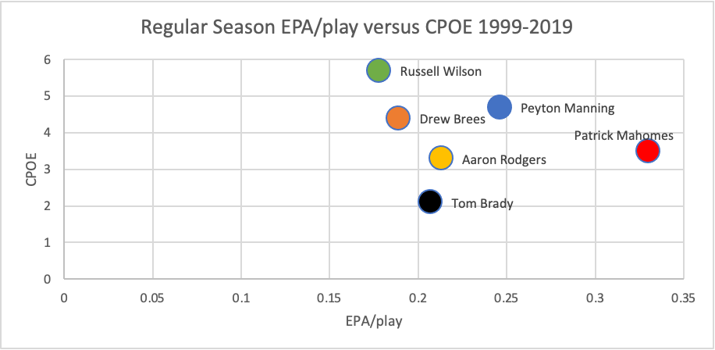

Slide 20
Analysis of regular season EPA/play and CPOE
Contrary to my initial belief, Aaron Rodgers is an average quarterback out of these 6. He has the 5th best CPOE and the 3rd best EPA/play. However, Tom Brady has the Lowest CPOE out of the 6 QBs and the 4th best EPA/play. Something finite however, is that Aaron Rodgers has better numbers than Brady in both EPA/play and CPOE. Peyton Manning has career longevity, the 2nd best CPOE and the 2nd best EPA/play, behind Patrick Mahomes, who has the best EPA/play and the 4th best CPOE. Not to get nitty-gritty into details, but it seems that because of the large statistical differences in CPOE between Drew Brees and Russell Wilson in contrast with Tom Brady indicates that they are better than Brady. Tom Brady has a lower EPA/play and CPOE than Rodgers, Manning and Mahomes, with a larger difference between CPOE than EPA/play for Wilson and Brees. While I consider EPA/play more effective than CPOE, I still believe that the difference in CPOE indicates better QB performance from Wilson and Brees. Making Brady the worst and least effective QB out of the 6. While rankings are all subjective, personally I would rank the QBs as Manning, Wilson, Rodgers, Mahomes (due to lack of longevity), Brees and Brady.

Slide 21
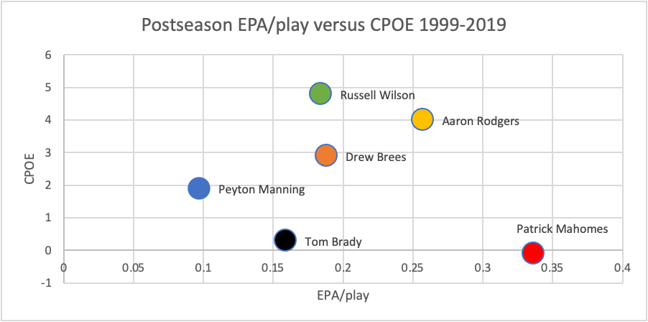

Slide 22
Analysis of postseason EPA/play and CPOE
While Patrick Mahomes has the best EPA/play out of the QBs, he also has a negative CPOE of -0.1. Aaron Rodgers has the 2nd best EPA/play and the 2nd best CPOE. Russell Wilson, again has the best CPOE and has the 4th (nearly 3rd) best EPA/play. As stated in earlier slides, Peyton Manning gets worse during the postseason. He had the 2nd best EPA/play in the regular season, but has the worst in the postseason and it’s not necessarily close. He also has the 4th best CPOE. Drew Brees is very average and solid, he has the 3rd best EPA/play and CPOE. Tom Brady, again is not the best playoff performer statistically as he has the 5th best EPA/play and CPOE. Due to how highly I value EPA/play, I would slightly rank Aaron Rodgers ahead of Russell Wilson then Drew Brees, Patrick Mahomes, Tom Brady and Peyton Manning. With Manning in last mostly due to the fact he has the worst EPA/play.

Slide 23
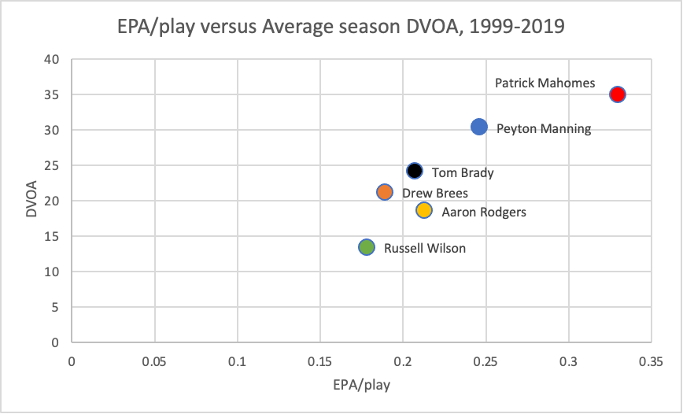

Slide 24
Analysis of EPA/play and DVOA
The last graph I chose to make, again Patrick Mahomes is the best. He easily has the best statistics of any QB ever, however in my opinion, the sample size is just so small to the point that it’s impossible to evaluate him in full especially in comparison to all these great Quarterbacks with 10+ years of NFL success. If he keeps up the same pace he’s been at, he will have a very good argument as the greatest QB of all time. As it is, based on all the data collected for EPA/Play and DVOA I would rank these QBs as Manning, Brady, Rodgers, Brees, and Mahomes slightly ahead of Wilson.

Slide 25
Analysis of EPA/play, CPOE, DYAR and DVOA
These 4 forms of data are all very good ways to measure effectiveness of QB play. I would consider the way to rank the variables as EPA/play, DVOA, CPOE and then DYAR. Therefore, I will make a composite score by weighing EPA/play 10000%, DVOA 100%, CPOE 400% and DYAR 1%. While I value DVOA above CPOE, DVOE values are normally 3-4 times higher than CPOE, so I chose to evaluate them on a similar percentage. DYAR values are so high that they would largely affect the sample so I weighed EPA/play to result those values similar to DYAR. The total composite turns out to be: [EPA/play (100) + CPOE (4) + DVOA (1) + DYAR (.01)].

Slide 26
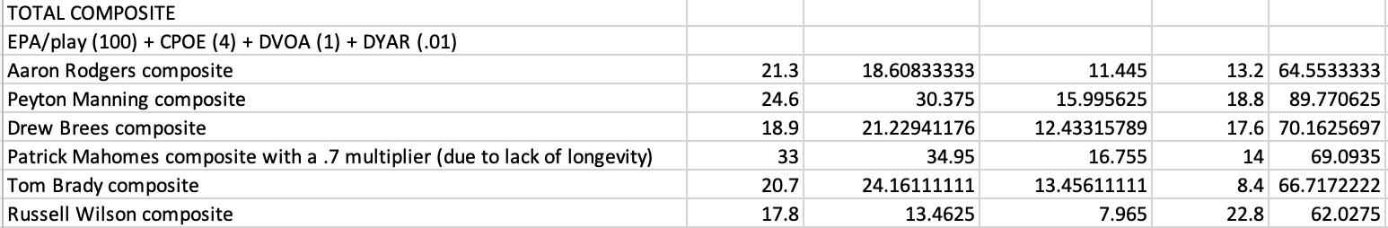
Composite Scores (1999-2019)
THE ORDER OF COMPOSITE SCORE GOES EPA/play, DVOA, DYAR and CPOE.
Based on these composite scores, the rankings go Peyton Manning, Drew Brees, Patrick Mahomes, Tom Brady, Aaron Rodgers and Russell Wilson.
While I don’t have playoff data for DVOA and DYAR, I do have the data for EPA/play and CPOE. This data just shows their performances based on regular season numbers, if you incorporate for their playoff numbers, you can create a multiplier for EPA/play and CPOE for their regular season performance based on how their percentages decrease or increase.

Slide 27
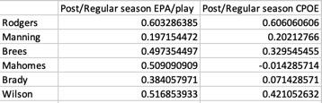
Playoff Change in composite scores
Based on EPA/play and CPOE data in the playoffs, I decided to use the change in data from the regular season in comparison to the playoffs as a multiplier to highlight the differences in playoff performance and highlight their overall performance incorporating their regular season and playoff performance. To find the multiplier for both EPA/play and CPOE I calculated the coefficient of the change in postseason performance for EPA/play and CPOE. I am going to use these numbers as multiplication coefficients for their respective EPA/play and CPOE, adding them to the overall composite score, giving an overall composite score for the best QBs incorporating the regular season and postseason. For example if a player’s rate of postseason/regular season EPA/play is .5 their overall EPA/play in the composite will be multiplied by .5. I multiplied both the postseason EPA/play and CPOE data by 0.5 because I believe the regular season should be weighed a lot higher than the postseason.

Slide 28
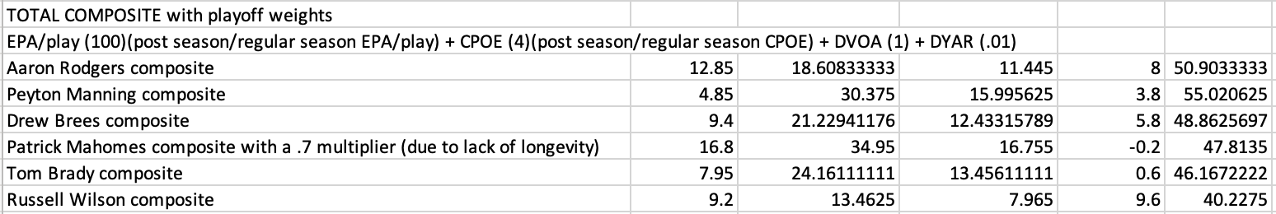
Overall composite score results given regular season and postseason data
These composite scores highlight the drop-off in playoff production for these QBs. Peyton Manning went from being the clear leader in composite score, to being closely regarded to the other QBs. Because of his improvement in postseason performance, Aaron Rodgers composite score actually improves based on his improved playoff performance. Something that’s also important from Aaron Rodgers’ improved playoff performance is that despite being the best postseason QB, he has only 1 Super Bowl to show for it. However, given that I trust this weighted data, I would rank the best QBs of all time for the 1999-2019 era as Peyton Manning, Aaron Rodgers, Drew Brees, Patrick Mahomes, Tom Brady and Russell Wilson. Rooted based on regular season and postseason EPA/play, DVOA, regular season and postseason CPOE and DYAR.

Slide 29
Conclusion
Data is subjective and there isn’t a correct finite way to say someone is the “best.” The reason why I included so much data is because there are so many different ways to evaluate Quarterbacks, and choosing one or two metrics for evaluation is super flawed. Especially if you choose a team metric like wins or a counting metric like yards or touchdowns. Brady, Rodgers, Mahomes and even Russell Wilson all have plenty more years of football to play and it’s possible that their composite scores could change drastically. However, as it is EPA/play, CPOE, DYAR and DVOA are really good metrics to use to evaluate player success and efficiency. I chose to weigh EPA/play super heavily, in addition to valuing DYAR very low. However, there are definitely people that prefer to use DYAR as a metric to evaluate Quarterbacks, and it’s not wrong for them to think like that, it’s just a preference. My preference for EPA/play is just the same as the common preference for wins as a QB stat (despite how little it makes sense in evaluating a player). Other data like Passer rating has been seen to be linked with success, yet I didn’t include it in my composite ranking. In addition to valuable percentage data like TD% and INT%. The beauty of sports is that there are so many different things that one can look at when evaluating different teams and different players. Especially in our current day and age of data and data analysis that we have available in order to evaluate different teams and players. Personally, I have always believed that Tom Brady has profited off of his extremely good defenses and coaches and now I have the data to prove it. Based on his regular season and playoff performance, through an extreme variety of statistics (Passer Rating, TD%, INT%, TD/INT, Comp%, TD/game, Yards/game, EPA/play, CPOE, DYAR and DVOA) based on the data it can be seen and concluded that Tom Brady is not the best Quarterback of all time. He is not the best in any of these metrics, and in addition to anecdotal evidence highlighting where and when he finds playoff success, and due to the fact that he is the only Quarterback out of these 5 QBs to have as good of a defense in the playoffs AND in the regular season given defense EPA/play. Tom Brady is extremely overrated and over credited for the team and organization accomplishments. There are no statistical metrics that provide any evidence or any argument as to why he is the greatest. With that being said, based on my weighted composite scores from EPA/play, DVOA, CPOE and DYAR given regular season and playoff data. I would rank the best QBs of all time (from 1999-2020) as Peyton Manning, Aaron Rodgers, Drew Brees, Patrick Mahomes, Tom Brady and Russell Wilson.

Slide 30
Sources Part IV
Unknown. (n.d.). What is DVOA? Football Outsiders. https://www.footballoutsiders.com/info/methods#dyar
Dave Archibald. (October 25, 2019). Glossary Entry: Expected Points Added. Inside the Pylon. http://insidethepylon.com/football-101/glossary-football-101/2019/10/25/glossary-entry-expected-points-added/
Joey DiCresce. (October 19, 2021). CPOE Explained. The 33rd Team. https://www.the33rdteam.com/cpoe-explained/
Unknown. (1998-2020). 1998-2020 Quarterbacks. Football Outsiders. https://www.footballoutsiders.com/stats/nfl/qb/1998, https://www.footballoutsiders.com/stats/nfl/qb/1999, https://www.footballoutsiders.com/stats/nfl/qb/2000, https://www.footballoutsiders.com/stats/nfl/qb/2001, https://www.footballoutsiders.com/stats/nfl/qb/2002, https://www.footballoutsiders.com/stats/nfl/qb/2003, https://www.footballoutsiders.com/stats/nfl/qb/2004, https://www.footballoutsiders.com/stats/nfl/qb/2005, https://www.footballoutsiders.com/stats/nfl/qb/2006, https://www.footballoutsiders.com/stats/nfl/qb/2007, https://www.footballoutsiders.com/stats/nfl/qb/2008, https://www.footballoutsiders.com/stats/nfl/qb/2009, https://www.footballoutsiders.com/stats/nfl/qb/2010, https://www.footballoutsiders.com/stats/nfl/qb/2011, https://www.footballoutsiders.com/stats/nfl/qb/2012, https://www.footballoutsiders.com/stats/nfl/qb/2013, https://www.footballoutsiders.com/stats/nfl/qb/2014, https://www.footballoutsiders.com/stats/nfl/qb/2015, https://www.footballoutsiders.com/stats/nfl/qb/2016, https://www.footballoutsiders.com/stats/nfl/qb/2017, https://www.footballoutsiders.com/stats/nfl/qb/2018, https://www.footballoutsiders.com/stats/nfl/qb/2019, https://www.footballoutsiders.com/stats/nfl/qb/2020, https://www.footballoutsiders.com/stats/nfl/qb/2021
https://rbsdm.com/stats/

